Slide 1

Sutex Bank College of Computer Applications & Science, Amroli
(Accredited ‘B’ (CGPA 2.55) by NAAC Dec.-2009)
VEER NARMAD SOUTH GUJARAT UNIVERSITY, SURAT
STUDENT HOUSING SYSTEM
PRESENTED BY :
Mr. KRUNAL M. DHARAIYA (317)
Mr. NIKUNJ N. KATARIYA (362)
Mr. SAGAR M. PIPALIYA (442)
GUIDED BY :
ASST. PROF. RINKU J. THAKKAR

Slide 2

Project profile
PROJECT DEFINITION
HARDWARE REQUIREMENTS
SOFTWARE REQUIREMENTS
DRAWBACKS OF EXISTING SYSTEM
SCOPE
EXPECTED ADVANTAGES
DATABASE DESIGN
DATA FLOW DIAGRAM
ER DIAGRAM
INPUT DESIGN
OUTPUT DESIGN
FUTURE ENHANCEMENT
REFERENCES

Slide 3


Project definition
The Student Housing System is developed to facilitate application for accommodation online.
Room allocation confirmations would be sent by email to students who were given accommodation.
The landlords who would like to give their property on rent to students can come on our site, register themselves and upload details of the property the want to rent.
The new residence application system will help to eliminate the paper- based applications thereby speeding up processing as details will be captured in the database.

Slide 4

Hardware requirement
PROCESSOR | INTEL(R) CORE(TM) I3-6006U CPU @ 2.00GHZ
RAM | 1.00 GB
HARD DISK | 50 GB

Slide 5

Software requirements
OPERATING SYSTEM | MICROSOFT WINDOWS XP,7,8.1,10
FRONT END | WAMPSERVER 2.5
BACK END | MYSQL 5.6.17
FRAMEWORK | CODEIGNITER 3.1.6
SOFTWARE | NET BEANS 8.2
BROWSERS | GOOGLE CHROME. MOZILLA FIREFOX. OPERA BROWSER. INTERNET EXPLORER.

Slide 6

DRAWBACKS OF EXISTING SYSTEM
The existing system is highly manual involving a lot of paper work, calculation & therefore may be erroneous. This has led to inconsistency & inaccuracy in the maintenance of the data.
The data which is stored on the paper only, may be lost, stolen or destroyed due to natural calamity like fire & water.
The existing system is sluggish & consumes a lot of time causing inconvenience to students & employees.
Due to manual nature, it is difficult to update, delete, add or view the data.
Since the number of students have drastically increased therefore maintaining & retrieving detailed record of every student is extremely difficult.

Slide 7

SCOPE
Our system will include following operations :
Application and room booking
Landlord properties
Rules of Conduct.
Online Payment.
Online Appointment.

Slide 8

EXPECTED ADVANTAGES
TYPE WISE SEARCHING
ONLINE BOOKING
VERIFIED PROPERTIES
EASY CANCELLATION

Slide 9
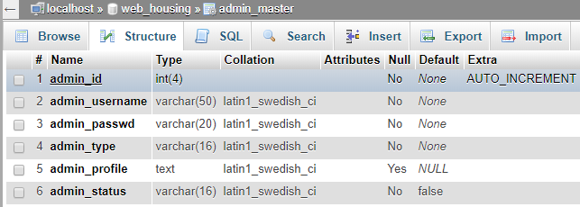

DATABASE DESIGN

Slide 10
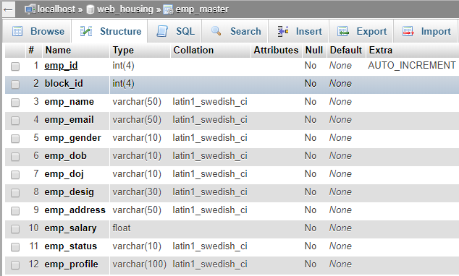

Slide 11
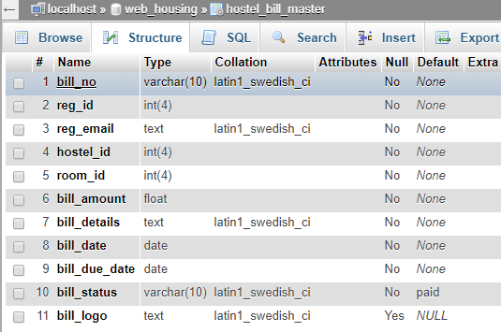

Slide 12
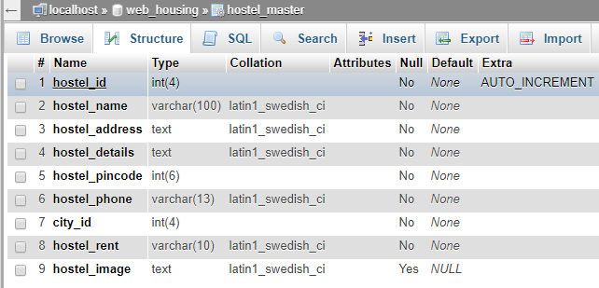

Slide 13
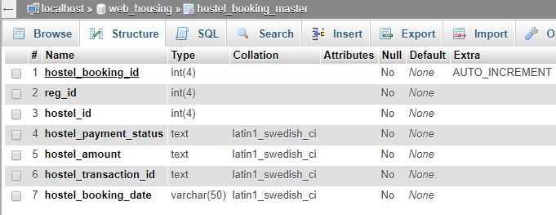

Slide 14
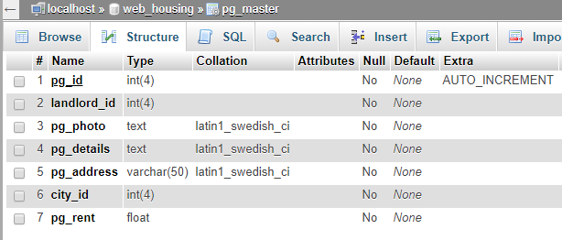

Slide 15
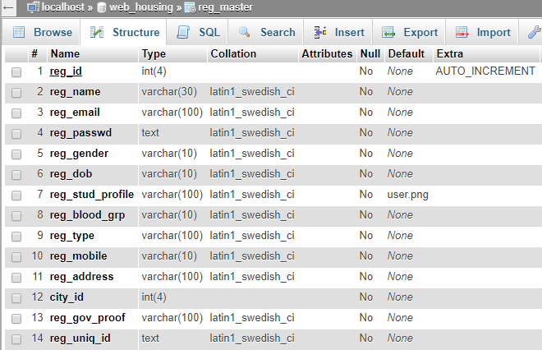

Slide 16
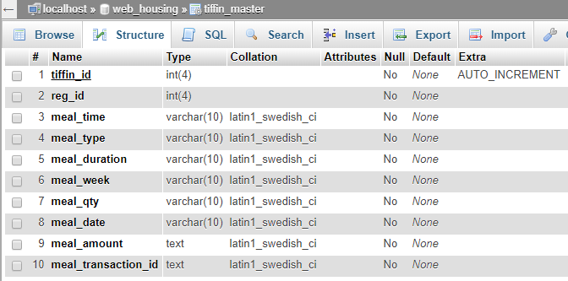

Slide 17
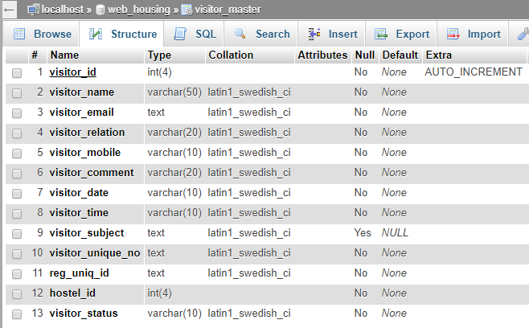

Slide 18
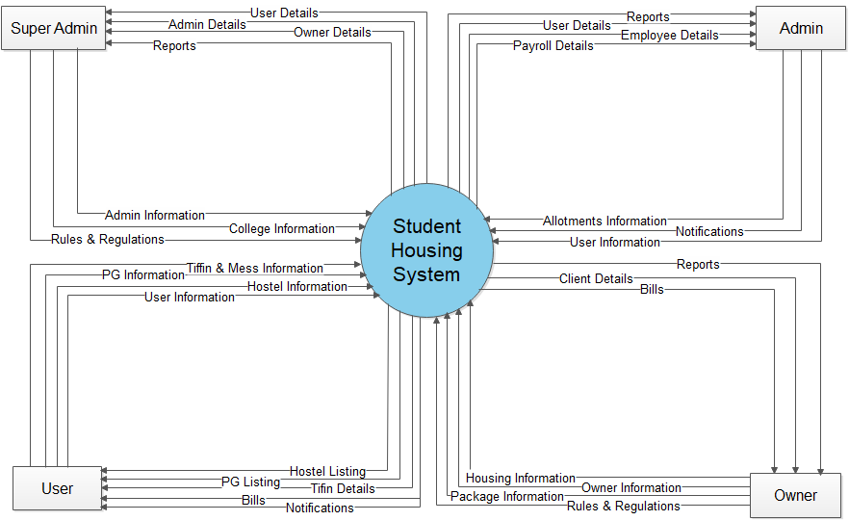
DATA FLOW DIAGRAM
Context Level DFD

Slide 19
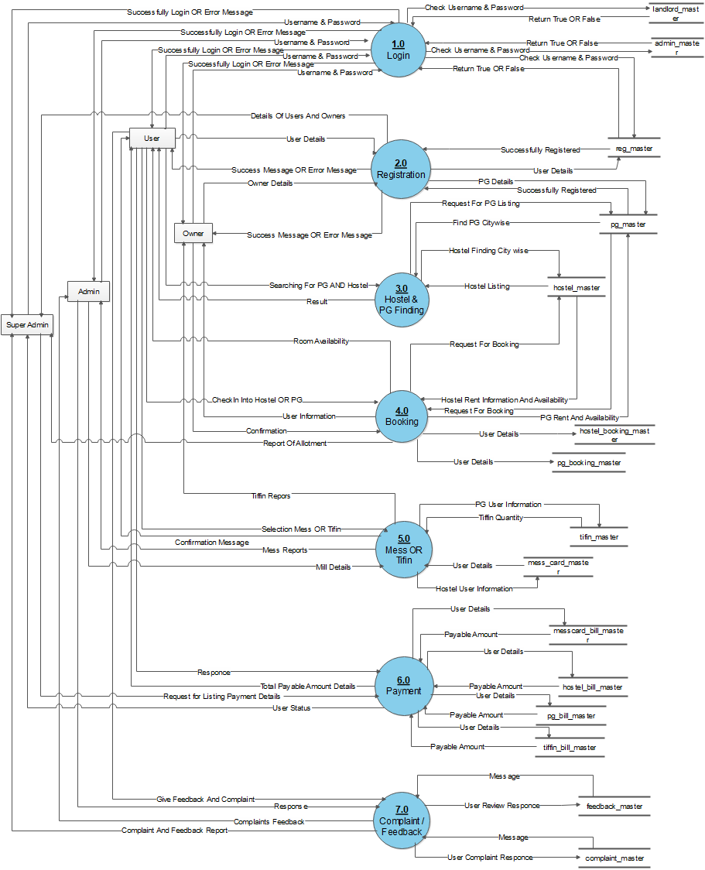
1st Level DFD

Slide 20
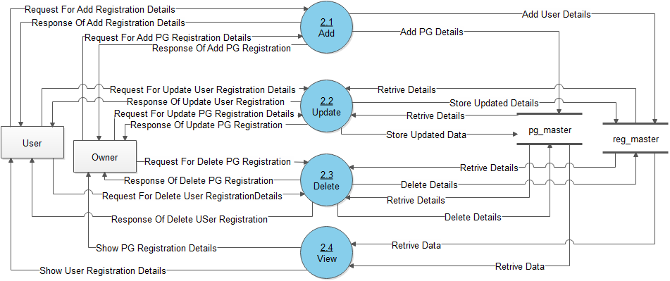
2nd Level DFD For Registration

Slide 21
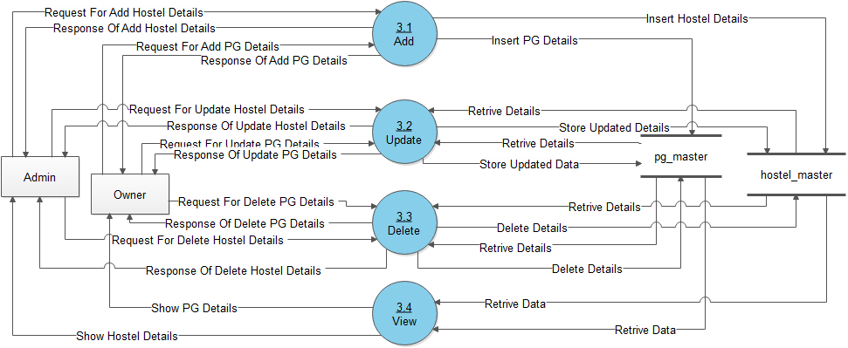
2nd Level DFD For Hostel & PG Finding

Slide 22
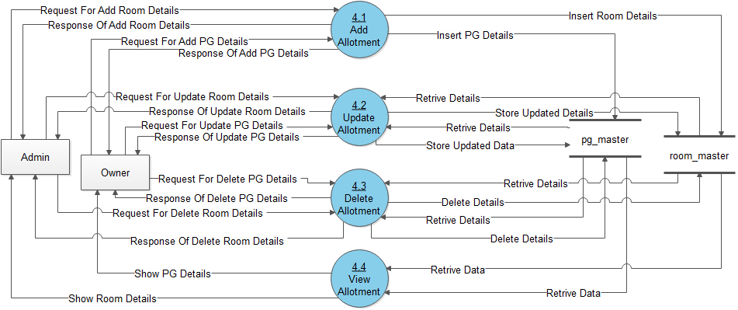
2nd Level DFD For Room Allotment

Slide 23
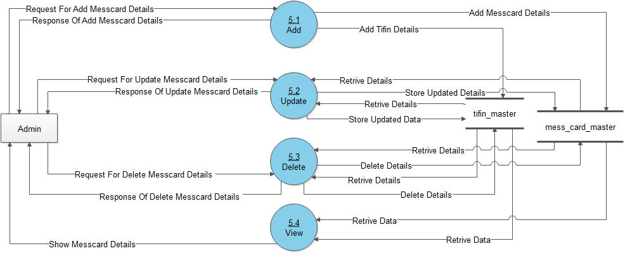
2nd Level DFD For Mess or Tiffin

Slide 24
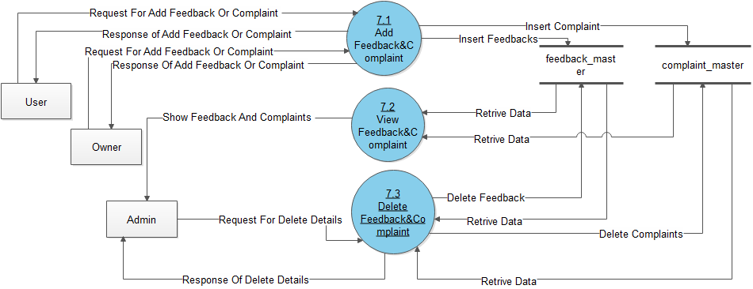
2nd Level DFD For Complaint & Feedback

Slide 25
ER DIAGRAM

Slide 26
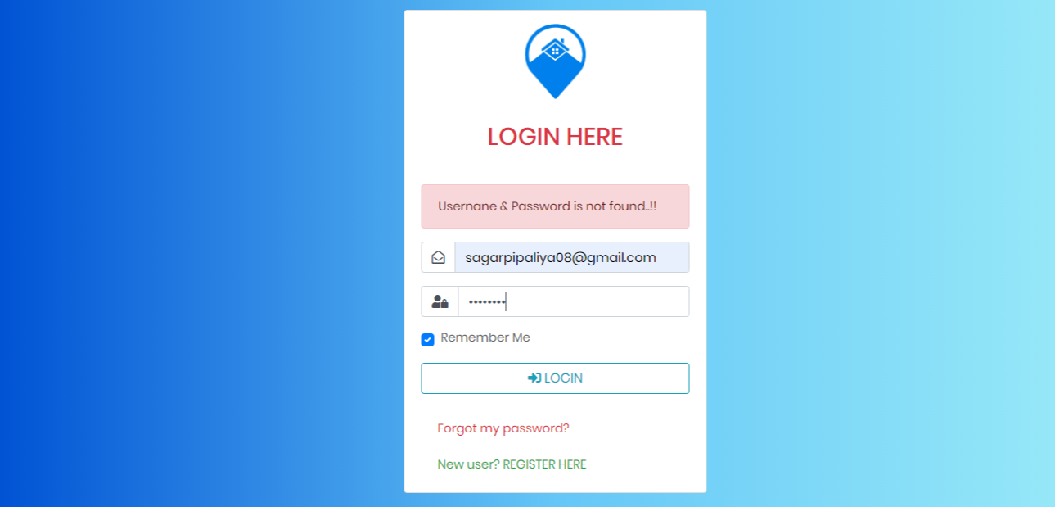
INPUT DESIGN
User Login Form with validations

Slide 27
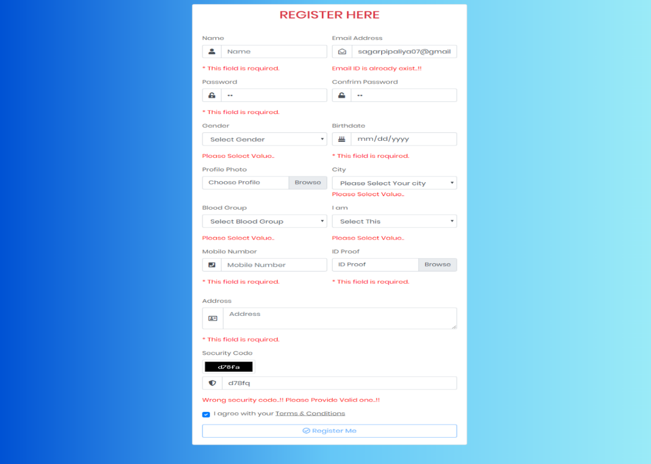
User Registration Form with validations

Slide 28
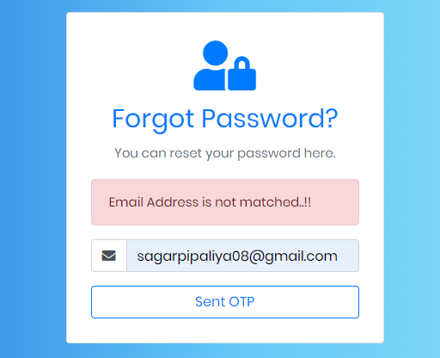
Forgot Password with validations (User)

Slide 29
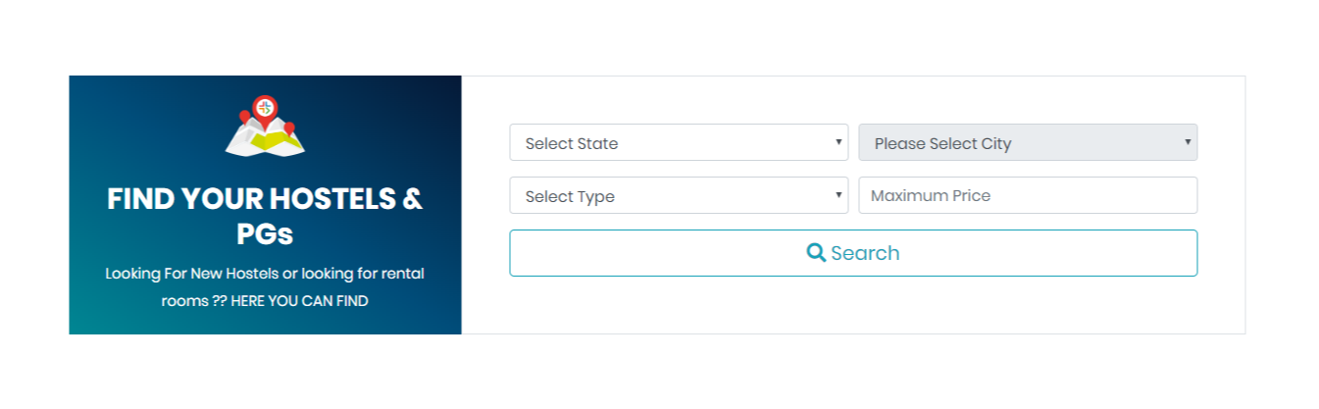
Searching (User)

Slide 30
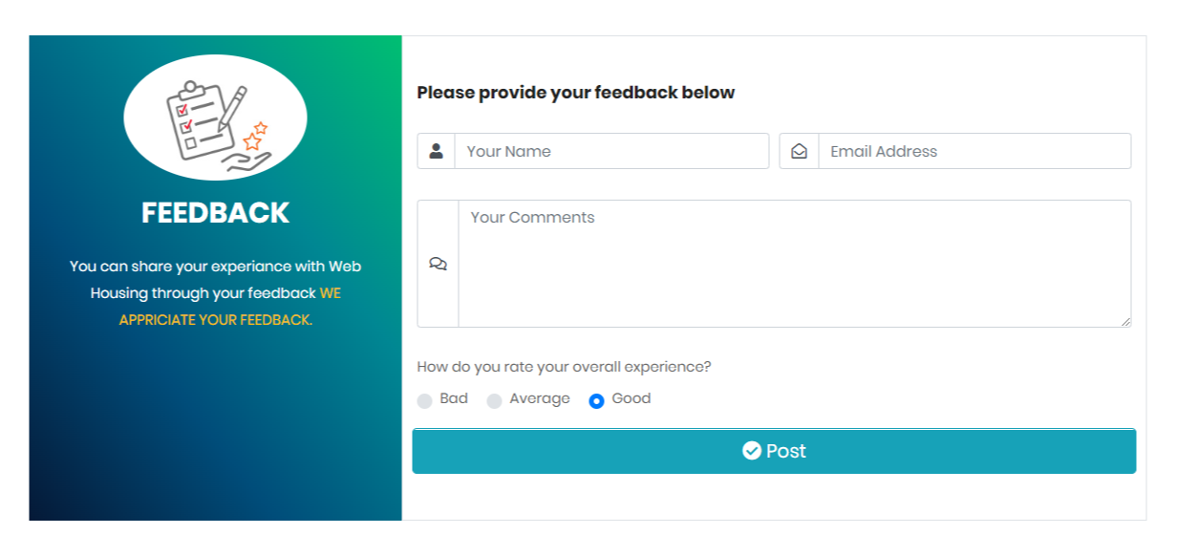
Feedback (User)

Slide 31
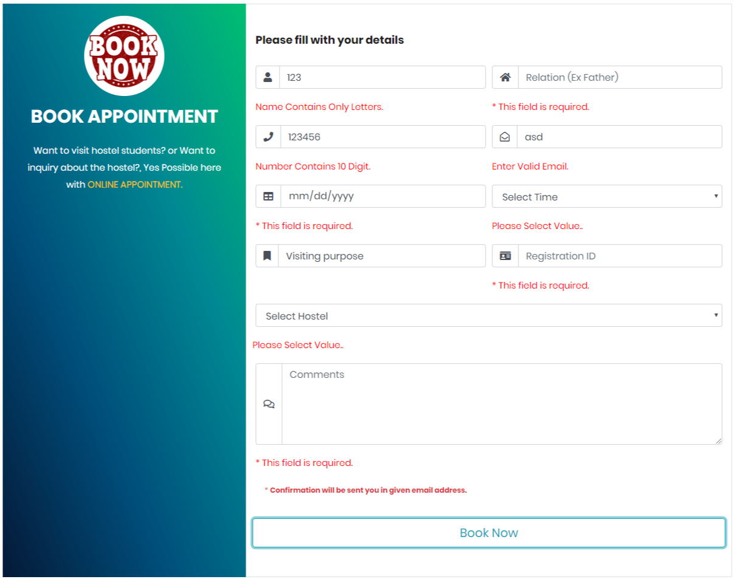
Appointment (User)

Slide 32
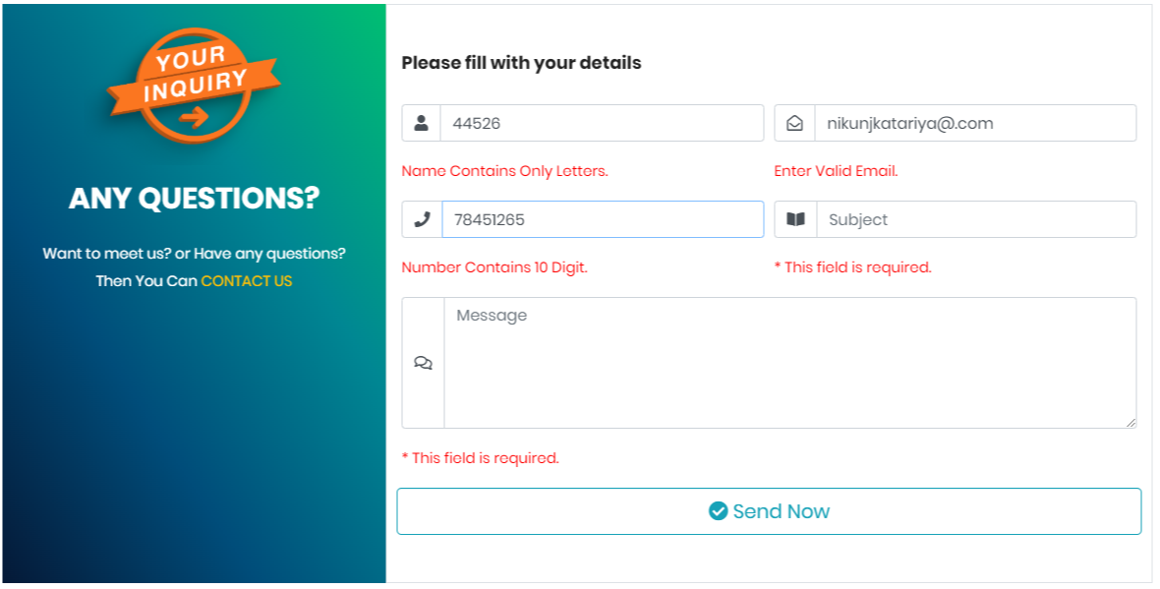
Inquiry (User)

Slide 33
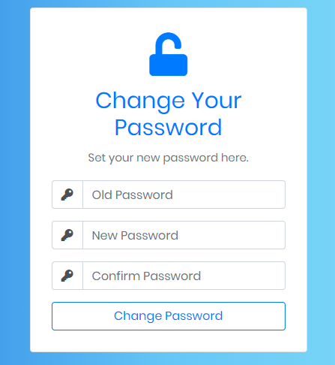
Change Password (User)

Slide 34
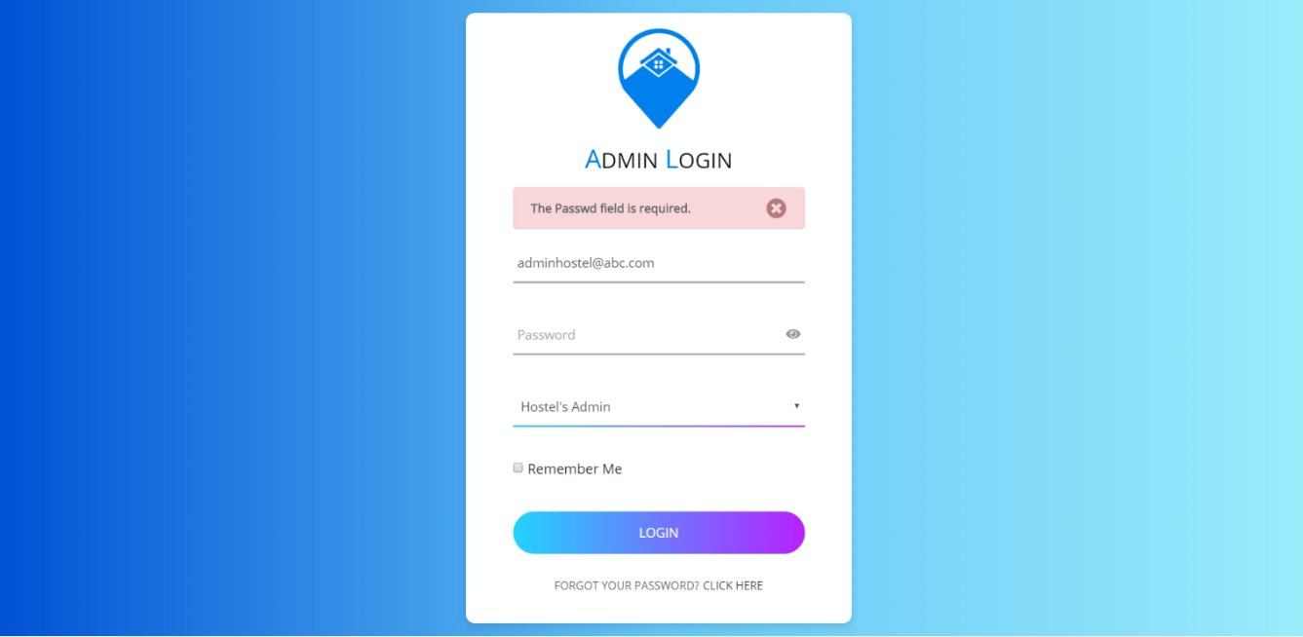
Admin Login

Slide 35
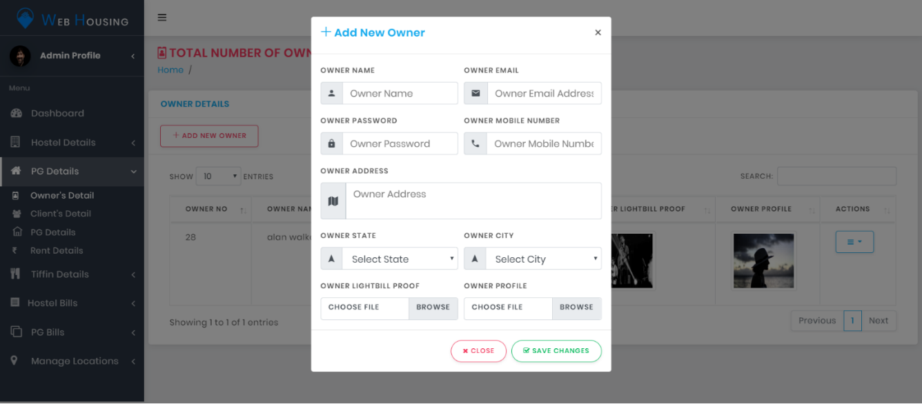
Add Records

Slide 36
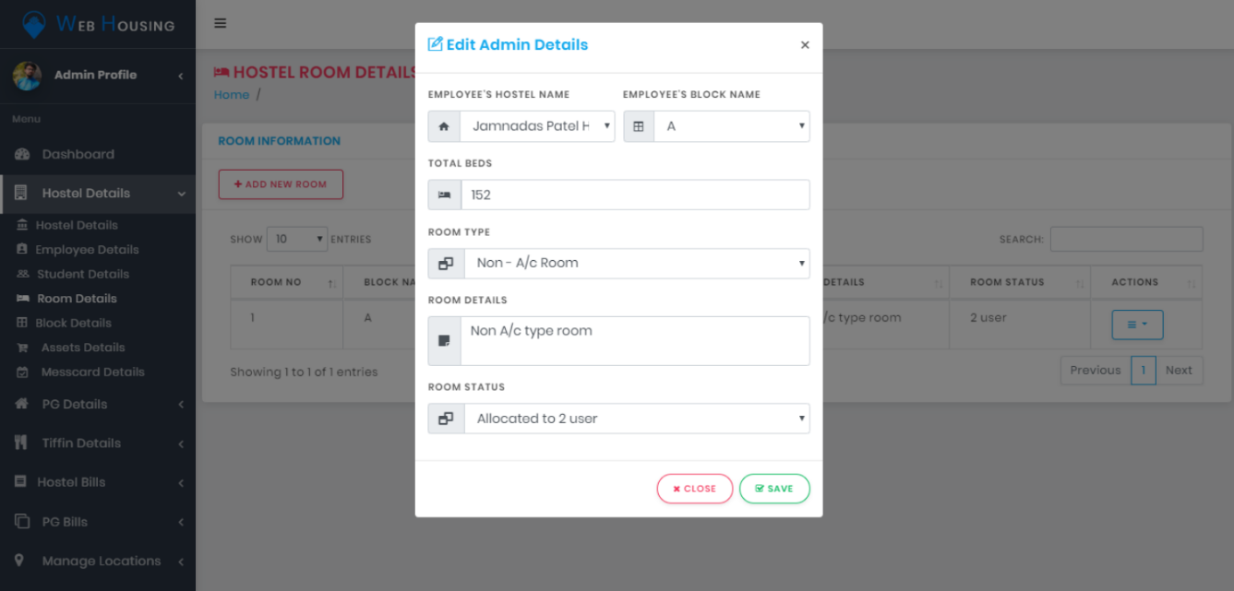
Edit Records

Slide 37
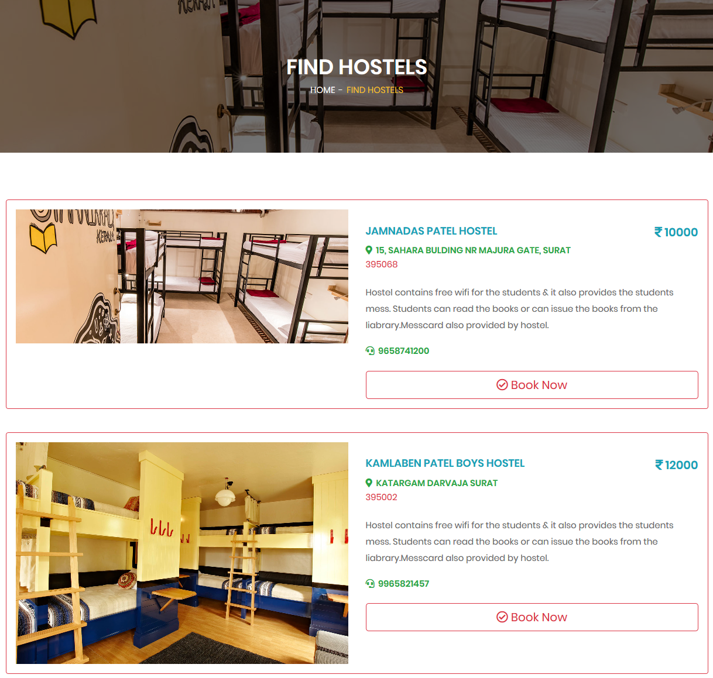
Output DESIGN
Search (User)

Slide 38
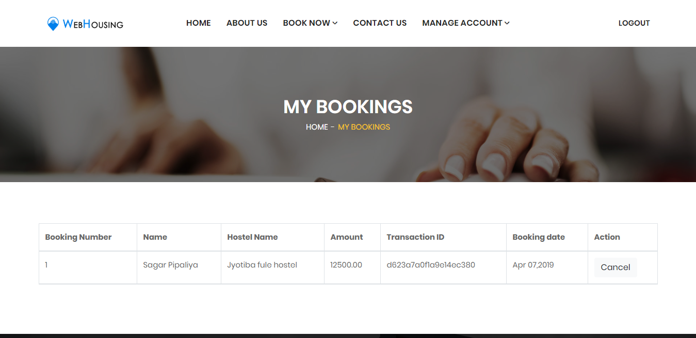
Bookings (User)

Slide 39
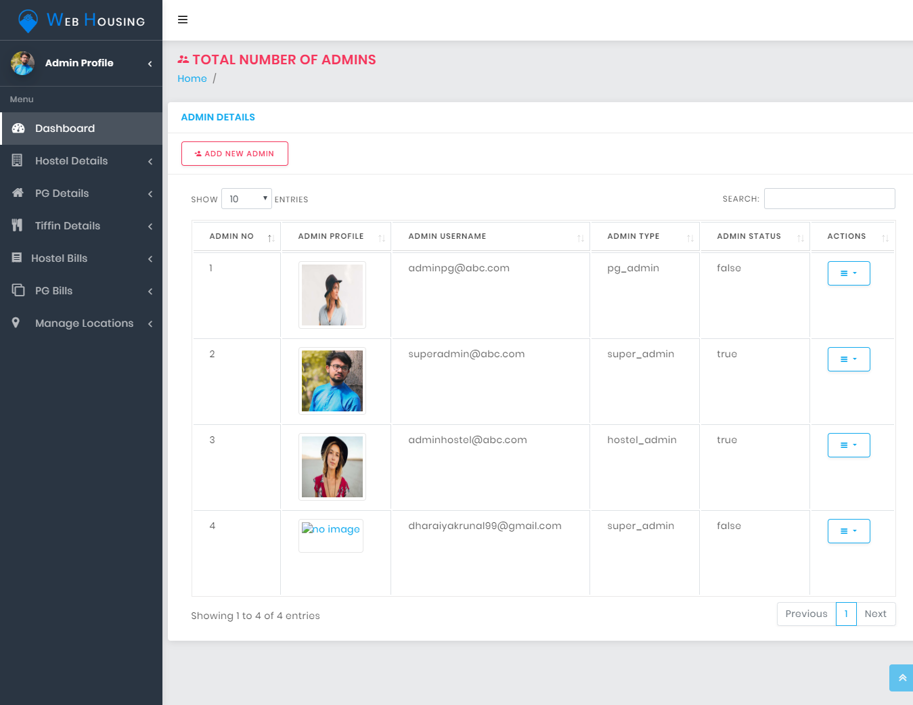
Display Records (Admin)

Slide 40
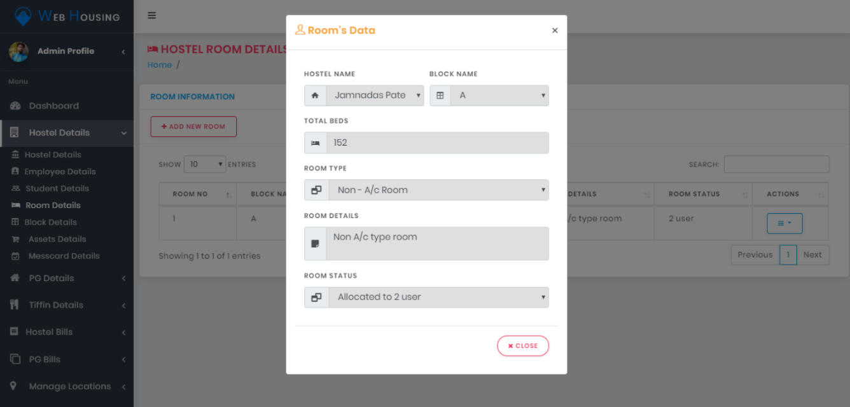
View Records (Admin)

Slide 41
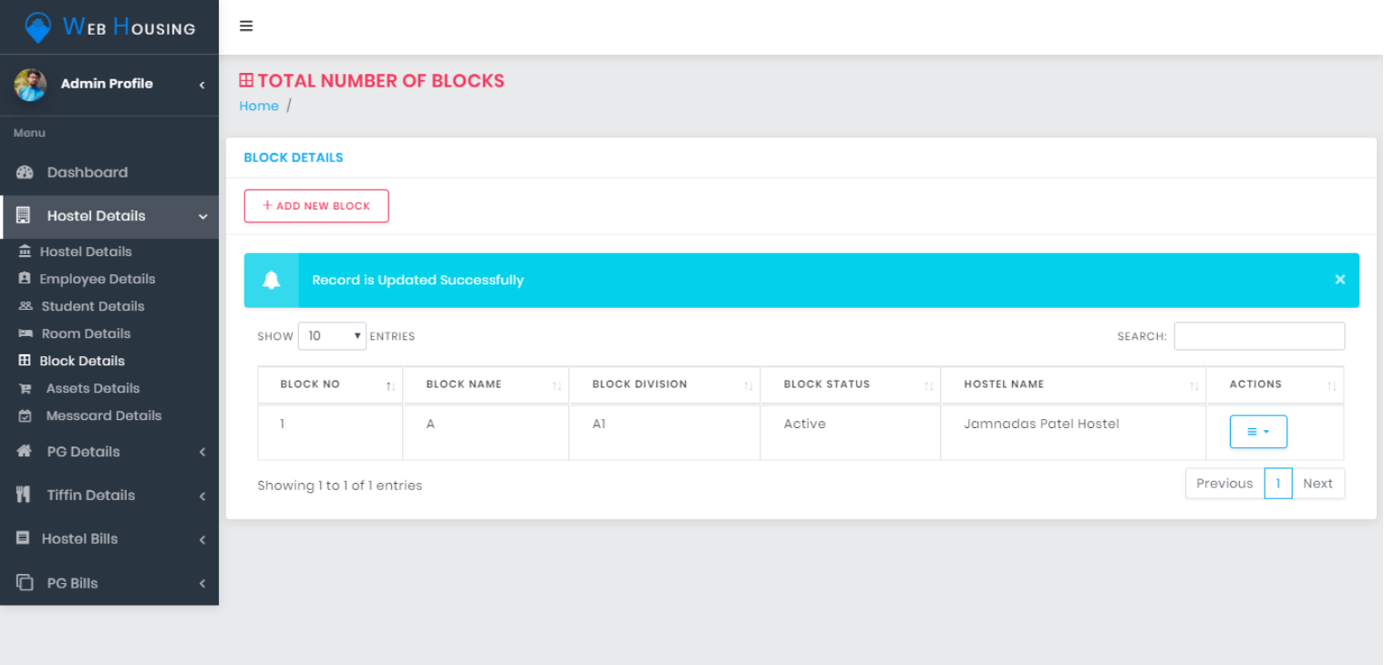
Update Records (Admin)

Slide 42
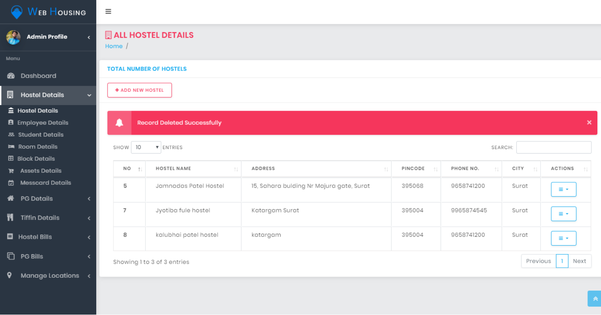
Delete Records (Admin)

Slide 43

FUTURE ENHANCEMENT
There is a possibility to create a chat server, through users can directly communicate with PG owners.
Improve the system security level of database & data transactions.
Allow others to give an advertisement in the system.

Slide 44

REFERENCES
https://www.academia.edu/32290841/A_Project_Report_On_Hostel_Management_System
https://www.slideshare.net/yogeshsharma647/hostel-management-system-80748575
https://docplayer.net/21011946-Hostel-management-system.html
https://www.educations.com/search/
https://www.student.com/us
https://www.student.com/ca
https://sha.com.au/
https://stackoverflow.com/questions/tagged/json

Slide 45


